Slide 1
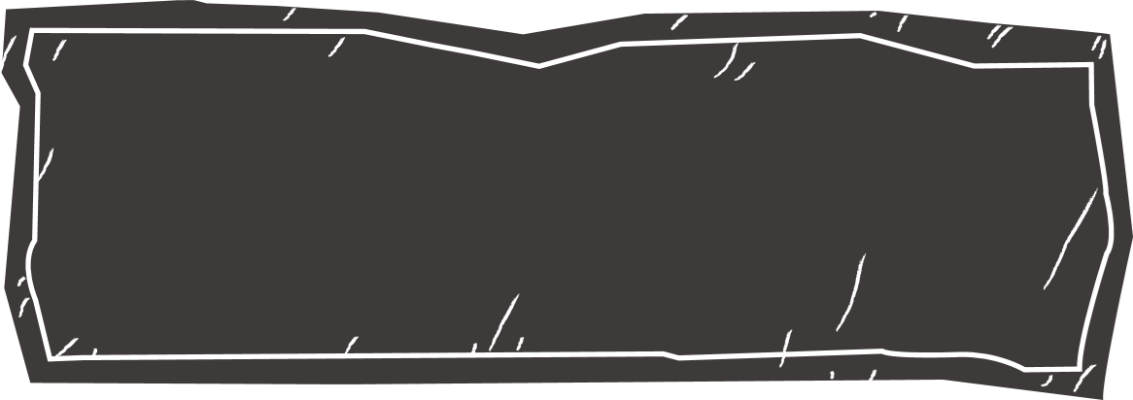
Creating 3D Virtual Models of Buildings

Slide 2
You have been given the task of creating a 3D virtual model of a building. Let’s think about it first: how do you accurately measure and determine the height of the building? In the real world, architects, engineers, and urban planners rely on mathematical concepts to estimate the dimensions of structures crucial for development and construction and development projects.
Imagine standing outside the building, equipped with simple tools and mathematical know-how, ready to estimate its height and then create its 3D model. Not only will you gain a deeper understanding of the mathematical concepts involved, but you will also witness firsthand how they are applied in practical, real-world situations.
Most importantly, you will learn to make assumptions and recognise limitations involved in creating the model, merely due to the lack of professional more advanced tools or precise measurements. In the future, we will be able to create more refined 3D models!

Slide 3
01
Activity1
To discuss a mathematical model of height estimation.

Slide 4
1. The following figure shows a podium ABCDEFGH.
A
1
B
C
2
D
E
3
F
H
G

Slide 5
(a) If AB = CD = EF = 60 cm, find the length HG of the podium.
A
1
B
C
2
D
E
3
F
H
G

Slide 6
(a) If AB = CD = EF = 60 cm, find the length HG of the podium.
A
1
B
C
2
D
E
3
F
H
G
Solution: HG = 60 cm × 3 = 180 cm

Slide 7
(b) It is known that BC = 32 cm . A student estimates the height AH as follows.
A
1
B
AH = 32 cm × 3 = 96 cm
D
C
2
E
3
F
H
G
What is the main assumption of his estimation?
Is the assumption reasonable?

Slide 8
The student assumes that each step is of equal height ( 32 cm ).
The assumption is reasonable because of design consistency. In many structures, stairs are often designed to have equal step heights. This design consistency helps ensure safety and ease of use, as people tend to expect uniformity in step heights when climbing stairs.

Slide 9
2. A student lives in a 17-storey building and wants to estimate its height. He proposes the following approach.
Step 1: Measure the height of one single step ( h ) in a flight of staircase.
Step 2: Count the number of steps ( n ) in one storey of the building.
Step 3: Count the number of storeys ( k ) in the building.
Step 4: Model formation: The height of the building= h · n · k

Slide 10
On the 12th floor, there are 16 steps in its flight of staircase. He measures the 7th step and finds that it has a riser height of 15.2 cm. Use his model to estimate the height of the building in m.
The height of the building
= h · n · k = 15.2 cm ×16 ×17 = 4134.4 cm
= 41 m

Slide 11
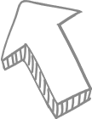
3. What are the assumptions and limitations of the model in Question 2?
Uniform step heights (h)
Perpendicular staircase
Same number of steps (k) for each storey (n)
Assumptions

Slide 12
3. What are the assumptions and limitations of the model in Question 2?
The model overlooks the sections extending beyond the staircase, such as the rooftop or other architectural components.
Limitations

Slide 13
4. What are some possible situational constraints of using this modelling approach?
Inaccessible areas: In some cases, certain sections of the building may be private areas and inaccessible for step counting and measurement.
Safety concern: There may be a potential risk associated with entering building staircases, especially in unfamiliar or unsecured environments.

Slide 14
02
Activity2A
To estimate heights
using trigonometric ratios.

Slide 15
1. In the figure, a tree BC casts a shadow 5.63 m long (AC) and ∠A=37°. Assume that BC⊥AC . Find the height of the tree BC.
B
A
5.63 m
C

Slide 16
1. In the figure, a tree BC casts a shadow 5.63 m long (AC) and ∠A=37°. Assume that BC⊥AC . Find the height of the tree BC.
Solution:
B
A
5.63 m
C

Slide 17
2. In the figure, a student stands at point B which is 8.45 m away from a tree CD. It is known that his eye level is 1.53 m above the ground. He finds that the angle of elevation of the top of the tree from his eye A is 26.7°. Find the height of the tree CD.
C
A
1.53 m
B
8.45 m
D

Slide 18
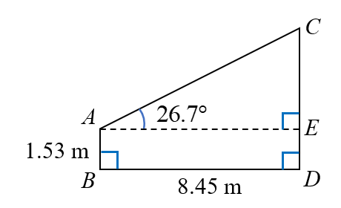
C
A
1.53 m
B
8.45 m
D
Solution：Draw AE ⊥ CD

Slide 19
3. Using the method in Question 2, we can estimate the height of a building.
(a) Make the necessary assumptions in the estimation.
(b) Hence, estimate the height h of the building. You may refer to the applet: https://www.geogebra.org/m/ymen6puf

Slide 20
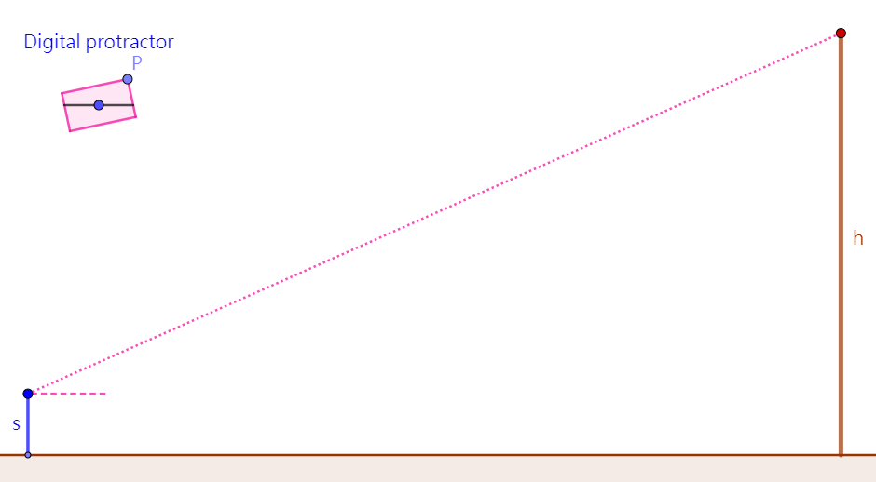
Angle of elevation = ____________
Student’s eye level s = ____________
Horizontal distance between the student and building = _____________

Slide 21
(a) Make the necessary assumptions in the estimation.
Ground conditions: The ground is free of irregularities, as they can affect the accuracy when measuring the horizontal distance between the student and building.
Ground level: The student’s standing position and the base of the building are at the same horizontal level.
Vertical building: The angle between the ground and the building is exactly 90°.

Slide 22
22.4°
Angle of elevation = ____________
1.65 m
Student’s eye level s = ____________
19.99 m
Horizontal distance between the student and building = _____________

Slide 23
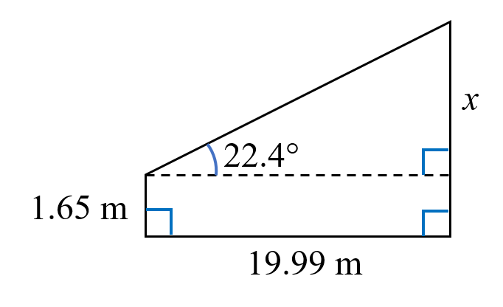
(b) Hence, estimate the height h of the building.
Solution：
From the student’s eye, draw a horizontal line perpendicular to the building.
Let x be the unknown, as shown in the figure.
∴ The height of the building is 9.89 m

Slide 24
4. What are some possible situational constraints in the above estimation?
Weather conditions: Bad weather conditions (e.g., heavy fog or rain) can obscure the view and affect the accuracy of the angle measurement.
Obstructions: There may be obstacles which block the way of measuring the distance between the student’s standing position and the base of the building.

Slide 25
02
Activity2B
(Enrichment Activity)
To estimate heights using trigonometric ratios, when measuring horizontal distances is not entirely feasible.

Slide 26
5. Example： Given that CDA is a straight line. Find the value of h.
B
h m
C
D
A
6.18 m

Slide 27
B
h m
C
D
A
6.18 m
Solution: In △ BCD , In △ ABC,

Slide 28
Solution: In △ BCD , In △ ABC,
By substituting (1) into (2), we have

Slide 29
6. Quick Practice:
In the figure, we want to estimate the height of a tree BC. It is known that ∠A = 30°, ∠BDC = 60°, and the distance between A and D is 9 m. Assume that ADC is a straight line and BC ⊥ AC. Find the height of the tree BC.
B
A
9 m
D
C

Slide 30
B
A
9 m
D
C
Solution: Let BC = h m and DC = x m
In △ BCD , In △ ABC,

Slide 31
Solution: Let BC = h m and DC = x m
In △ BCD , In △ ABC,
By substituting (1) into (2), we have
∴ BC = 7.79 m

Slide 32
7. Using the method in Question 6, we can estimate the height of the building.
(a) Make the necessary assumptions in the estimation.
(b) Hence, estimate the height h of the building.
You may refer to the applet: https://www.geogebra.org/m/djurma4f

Slide 33
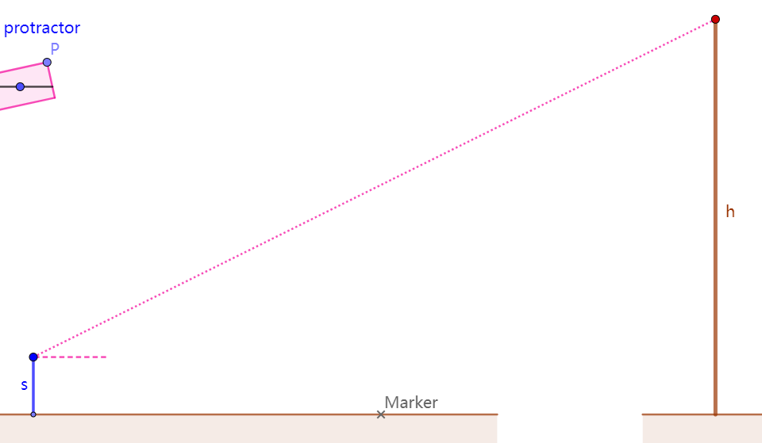
The first angle of
elevation = ____________
The second angle of
elevation = ____________
Student’s eye level s = ____________
Horizontal distance between the first and second positions = _____________

Slide 34
(a) Make the necessary assumptions in the estimation.
Ground level: The student’s two standing positions and the base of the building are at the same horizontal level and colinear.

Slide 35
The first angle of
elevation = ____________
The second angle of
elevation = ____________
22.8°
48.5°
1.65 m
Student’s eye level s = ____________
12.26 m
Horizontal distance between the first and second positions = _____________

Slide 36
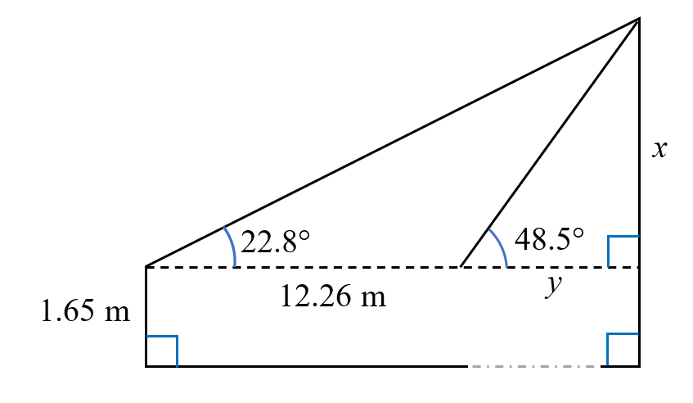
(b) Hence, estimate the height h of the building.
Solution:
From the student’s eye, draw a horizontal line perpendicular to the building.
Let x and y be the unknowns, as shown in the figure.

Slide 37
∴ The height of the building is 9.86 m.
By substituting (1) into (2), we have

Slide 38
03
Activity3
To create a virtual 3D-model of a building.

Slide 39
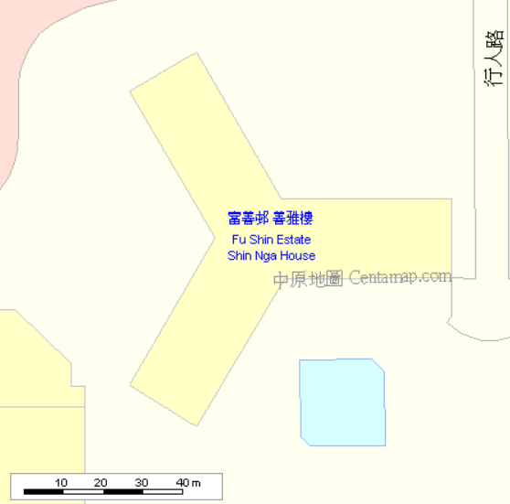
1. After estimating the height of a building, we can use a map to find its lateral dimension.
There are some online maps in Hong Kong. For example:
Centamap.com: http://hk.centamap.com/gc/home.aspx
Screen-capturing or downloading
the map of the target building
alongside the scale will enable us
to create its 3D-model
based on the scale.
With the height and lateral dimension of the building, we can create a virtual 3D-model using GeoGebra.

Slide 40
2. Go to GeoGebra official website: https://www.geogebra.org/classic
We can set the language of GeoGebra:
Main manual (top right-hand corner)
⁝
Settings / 設定 / 设置
→ Select your preferred language

Slide 41
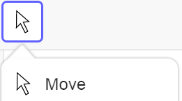
Tips
In GeoGebra, after using a tool, it is a good practice to select “Move” tool. You can understand this practice as:
Pick up a tool
→
Use the tool
→
Put down the tool

Slide 42
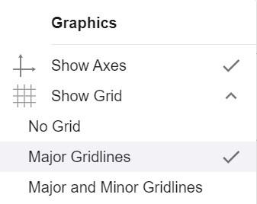
3. The following steps will guide us through creating a 3D-model of a building.
01
Set the gridlines Right-click on the graphics view “Show Grid” → Tick “Major Gridlines”

Slide 43
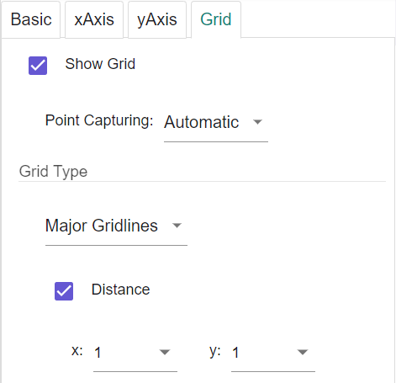
02
Set the distance of the grid Right-click on the graphics view Click “Graphics” Go to “Grid” tab → “Grid Type” → Select “Major Gridlines” Tick “Distance” Set x = 1 and y = 1
Remark: This will be useful for you to define the scale of your 3D-model.

Slide 44
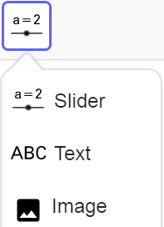
03
Import the map of the building Use “Image” tool to select an image from files Go to “Upload” tab → “BROWSE” Upload the map

Slide 45
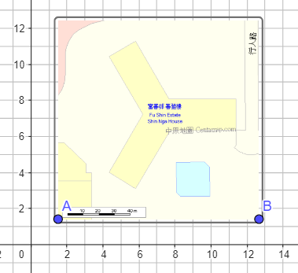
03

Slide 46
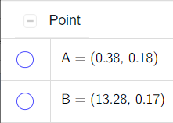
04
Adjust the size of the map Move Points A and B to adjust the size of the map Hide Points A and B
Remark: If the interval of the gridline matches with the scale of the map, it will be easier to get the proportions right when creating your 3D-model.

Slide 47
05
Draw the base of the building Use “Point” tool to draw the vertices of the building
Use “Polygon” tool to connect all vertices to draw the base of the building

Slide 48
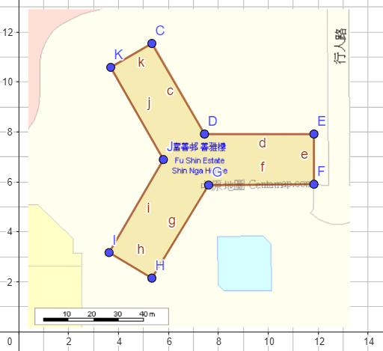
05

Slide 49
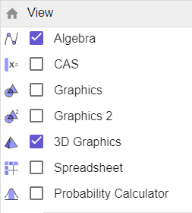
06
Show the 3D Graphics view “Main manual” (top right-hand corner) → “View” Tick “3D Graphics” view Untick “Graphics” view Adjust the view

Slide 50
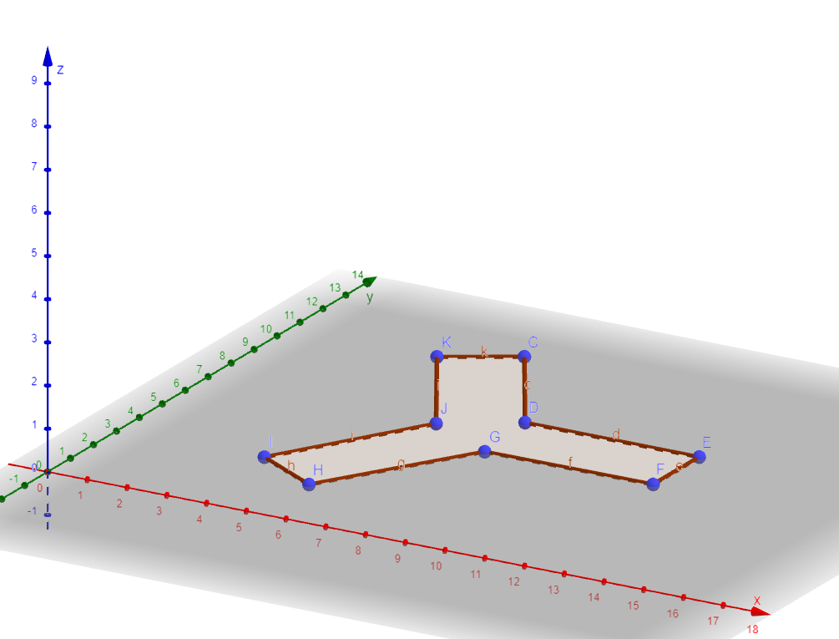
06

Slide 51
Tips
To adjust the 3D Graphics view, Use “Move Graphics View” tool
First, you can move it vertically
After one click, you can move it horizontally
There are some useful buttons at the bottom right-hand corner Standard View: Go back to the initial position and view Zoom In Zoom Out

Slide 52
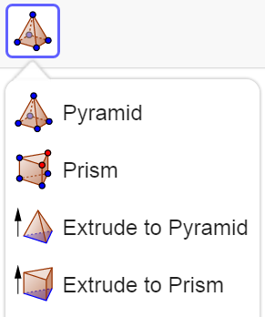
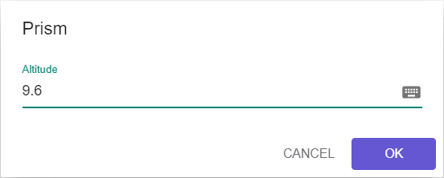
07
Create the building (taking a 96-metre-tall building as an example, according to the scale of the map, we need to input 9.6) Use “Extrude to Prism” tool and click the base of the building Input 9.6 as its Altitude

Slide 53
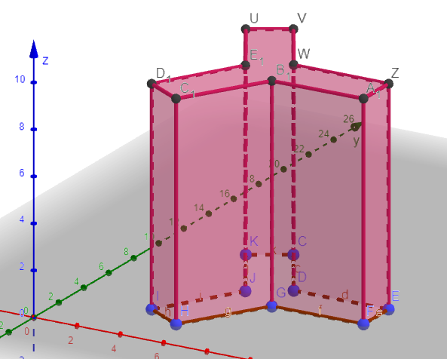
07

Slide 54
4. What are the assumptions of this 3D-model?
Building shape: The building is a prism, having a uniform cross-section along its entire height.
The top of the building: The roof or uppermost floor of the building is perfectly level.

